Slide 1


Front end
(Introduction to css)
Lecture-11a

Slide 2

Today’s Agenda
Introduction To CSS
Advantages Of CSS
Versions Of CSS
Types Of CSS
CSS Selectors

Slide 3
What Is CSS ?
Cascading Style Sheets, popularly called CSS, is a simple design language intended to simplify the process of making web pages presentable.
CSS handles the look and feel part of a web page.
Using CSS, we can control:
the color of the text
the style of fonts
how tables are sized and laid out
what background images or colors are used
as well as a variety of other effects.

Slide 4
Advantages Of CSS
CSS saves time
Pages load faster
Easy maintenance
Superior styles to HTML
Making The Site Responsive

Slide 5

What Is Responsive Web Design ?

Slide 6

What Is Responsive Web Design ?

Slide 7
Who Maintains CSS ?
CSS is created and maintained by a group of people within the W3C called the CSS Working Group.
The CSS Working Group creates documents called specifications.
These specifications are called recommendations because the W3C has no control over the actual implementation of the language. It depends on the browser.

Slide 8
CSS Versions
CSS1(1996): Enabled users to set font size , align text, set margins and apply background and foreground colors
CSS2 (1998) Included features such as design styles for different devices
CSS3(2005) Includes text effects such as drop shadows and web fonts , semitransparent colors as well as animations

Slide 9
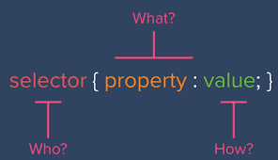
CSS Syntax
The syntax for CSS is different than that of HTML markup but is case insensitive.
It consists of only 3 parts, and they are :

Slide 10
CSS Syntax
Selector: A selector is an HTML tag on which style will be applied. This could be any tag like <h1> or <table> etc.
Property: A property is a type of attribute of HTML tag. Put simply, all the HTML attributes are converted into CSS properties. They could be color or border etc.
Value: Values are assigned to properties.
For example: color property can have value either red or #F1F1F1 etc.

Slide 11
Example
<html>
<head>
<style type=“text/css”>
p
{
color:red;
text-align:center;
}
</style>
</head>
<body>
<p>Hello World!</p>
<p>This paragraph is styled with CSS.</p>
</body>
</html>

Slide 12
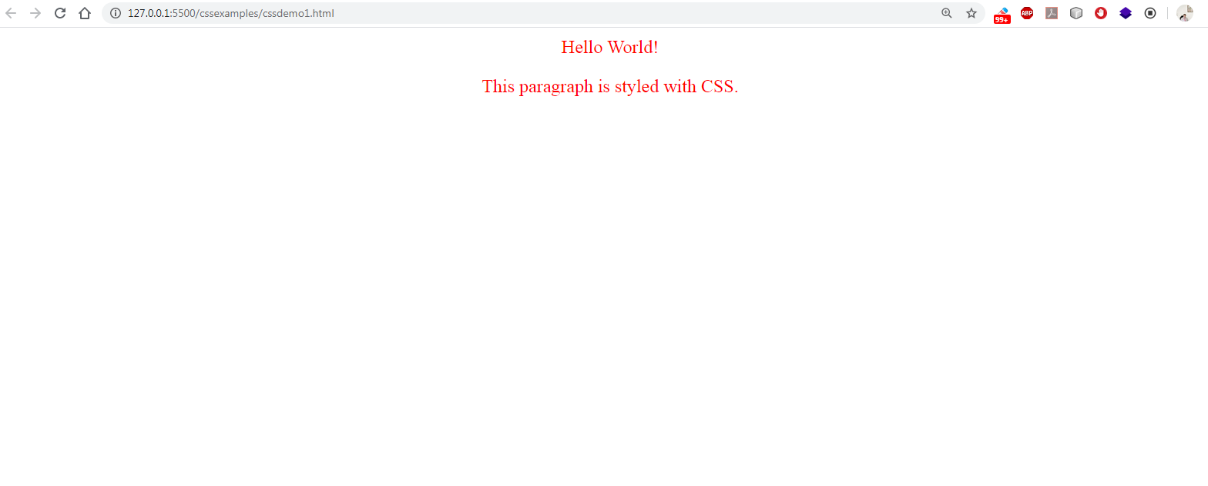
Output

Slide 13
Types Of CSS Files
There are 3 choices available to use CSS in our HTML file:
Internal CSS
External CSS
Inline CSS

Slide 14
Internal CSS
In this ,we place the CSS code within the <head></head> tags of each HTML file which we want to style with CSS.
The format for this is:
<head>
<title>….</title>
<style type=”text/css”>
CSS Content Goes Here
</style>
</head>

Slide 15
Internal CSS
In Internal CSS , each HTML file contains the CSS code needed to style the page.
Meaning that any changes we want to make to one page, will have to be made to all.
Internal CSS is good only if we need to style just one page, or if we want different pages to have varying styles.

Slide 16
External CSS
In this ,we place the CSS code within a separate file and save it with .css extension.
Then in the <head>section of each HTML file which we want to style with CSS we use the <link> tag to link the CSS file.
The format for this is:
<head>
<title>…</title>
<link rel=”stylesheet” type=”text/css” href=“Path To css file” />
</head>

Slide 17
External CSS
By using an external style sheet, all of our HTML files link to one CSS file in order to style the pages.
This means, that if we need to alter the design of all our pages, we only need to edit one .css file to make global changes to our entire website.
Here are a few reasons why this is better.
Easier Maintenance
Reduced File Size
Improved Flexibility

Slide 18
Inline CSS
Inline styles are CSS styles that are applied to one element using the “style” attribute.
An inline style can be used if a unique style is to be applied to one single occurrence of an element.
It’s format is:
<body>
< tag style=“css property” > some text</tag>
</body>

Slide 19
Cascading Order
How browser decides what style will be used when there is more than one style specified for an HTML element?
Generally speaking we can say that all the styles will "cascade" into a new "virtual" style sheet by the following rules, where number four has the highest priority:
Browser default
External style sheet
Internal style sheet (in the head section)
Inline style (inside an HTML element)

Slide 20
Comments In CSS
Comments are used to explain our code, and may help us when we edit the source code at a later date.
A CSS comment begins with "/*", and ends with "*/“.
<style>
p
{
/*color:red; */
text-align:center;
}
</style>

Slide 21
Quiz Time
What is a RuleSet in CSS ?
A. The instruction on how to style a CSS property
B. A combination of WHAT to style and HOW to style
C. The link tag that includes an external CSS
Answer: B

Slide 22
Quiz Time
Which type of CSS is least recommended ?
A. Inline CSS
B. Internal CSS
C. External CSS
Answer: A

Slide 23
Quiz Time
Which type of CSS has the highest priority ?
A. Inline CSS
B. Internal CSS
C. External CSS
D. Browser Default
Answer: A

Slide 24
Selectors In CSS
Selector is used to select or point to a specific element within the page.
Following are the most commonly used selectors:
Universal Selector
Type Selector
ID Selector
Class Selector

Slide 25
The Universal Selector
The Universal Selector is indicated by * and applies to all the elements of a page.
For example :
The following rule set changes all the element font name to “Arial”
*
{
font-family: Arial;
}

Slide 26
The Type Selector
The Type Selector allows us to create styles that apply to a specific type of HTML element.
The style will be applied to all the elements of that type in the web page.
For example :
The following rule set changes color of all h1 tags to green
h1
{
color: green;
}

Slide 27
The ID Selector
The Id selector is always prefixed by a hash symbol(#) and allows us to refer to a single element in a page.
With Id selector we can change the appearance for that single element.

Slide 28
The ID Selector
For example :
The following rule set changes font style to italic for element whose id is “intro”
#intro
{
font-style: italic;
}

Slide 29
The Class Selector
The Class Selector enables us to style multiple HTML elements through the class attribute.
It is always prefixed by a dot symbol(.)
Class selector enables to apply same type of formatting to a number of unrelated elements.

Slide 30
The Class Selector
For example :
The following rule set changes font and color for element with class “highlight”
.highlight
{
font-weight: bold;
color: red;
}

Slide 31
ID v/s Class
There is often confusion about when it is appropriate to use CSS IDs and when CSS Classes should be used.
The difference between an ID and a class is that an ID can be used to identify one element, whereas a class can be used to identify multiple elements.
Thus,ID's are unique
Each element can have only one ID
Each page can have only one element with that ID
Classes may or may NOT be unique
We can use the same class on multiple elements.
We can have multiple classes allotted to the same element

Slide 32
Grouping Selectors
Grouping of selectors is done when we want to apply the same style to different elements.
For example:
h1,h2,h3,h4,h5,h6
{
color:red;
}

Slide 33
Combining Selectors
Combining selectors is done so that we can select an element with specific properties using multiple selectors.
For example:
p.main
{
font-size: 26px;
}
The above rule set says:
Change the font size of only those “paragraphs” which have a class attribute set to “main”

Slide 34
Combinators
A combinator is a way to define the relation between selectors.
By using combinators, for example, we can target only child elements of a parent element, or we can target an element followed by another element on the same level and like that.

Slide 35
Types Of Combinators
There are 4 types of combinators as:
descendant selector (space)
adjacent sibling selector (+)
general sibling selector (~)
child selector (>)

Slide 36
Descendent Selectors
In CSS, a descendant means an element that is a child, grandchild, great grandchild, and so on,of another element.
Descendant selectors apply style based on whether one element contains another.

Slide 37
Descendent Selectors
For Example:
p a
{
font-weight: bold;
color: red;
}
The above rule applies to all the anchors which are placed within the <p> tag.

Slide 38
Exercise 1
Explain the following rules:
h1 em
{
color:#FF0000;
}
Convert all <em> text color to red if they are within the <h1> tag

Slide 39
Exercise 2
Explain the following rules:
p#pagecontent
{
text-transform: uppercase;
}
Change the text of all <p> tag whose id is pagecontent to UPPERCASE

Slide 40
Exercise 3
Explain the following rules:
p#pagecontent li
{
text-transform: uppercase;
}
Change the text of list elements which are within a <p> tag whose id is pagecontent to UPPERCASE

Slide 41
Exercise 4
Explain the following rules:
#one.two
{
color: red;
}
Make the text color of all such elements to red who have their id value as “one” and class value as “two”.
For example:
<h1 id="one" class="two">This Should Be Red</h1>

Slide 42
Exercise 5
Explain the following rules:
#one .two
{
color: red;
}
Make the text color of all such elements to red who have their class value as “two” and are descendents of an element with id value as “one”
For example:
<p id="one“>
<a href=“contact.html” class=“two”>Contact Page</a>
</p>

Slide 43
Adjacent Sibling Selectors
In CSS, a adjacent sibling means an element that appears next to the current element and has the same parent.
For ex:
<body>
<p>I am para 1</p>
<a href=“#”>I am anchor 1</a>
</body>
In the above code snippet the <a>tag is the adjacent sibling to <p> as it comes just after the <p> and has the same parent as <p>

Slide 44
Adjacent Sibling Selectors
Syntax:
<first tag> + <second tag>+ ….
{
// CSS properties
}

Slide 45
Adjacent Sibling Selectors
For Example:
p + h2
{
color: red;
}
The above rule applies to all the <h2> which are placed just after a <p> tag and have the same parent
<div>
<h2>I am heading</h2>
<p>I am para</p>
<h2>I am heading</h2>
<h3>I am heading</h3>
<p>I am para</p>
<h1>I am heading</h1>
<h2>I am heading</h2>
<p>I am para</p>
</div>

Slide 46
General Sibling Selectors
In CSS, a general sibling means an element that appear after the current element at the same level but not necessarily directly after it and has the same parent.
For ex:
<body>
<p>I am para 1</p>
<h2>I am heading</h2>
<h2>I am heading</h2>
</body>
In the above code snippet both <h2>tag are the general sibling to <p> as they have the same level as the <p> tag and have the same parent as <p>

Slide 47
General Sibling Selectors
Syntax:
<first tag> ~ <second tag> ~ . .
{
// CSS properties
}

Slide 48
General Sibling Selectors
For Example:
h2 ~ p
{
color: red;
}
The above rule applies to all the <p> which are placed after an <h2> tag and have the same parent
<div>
<h2>I am heading</h2>
<p>I am para</p>
<h2>I am heading</h2>
<h3>I am heading</h3>
<p>I am para</p>
<h1>I am heading</h1>
<h2>I am heading</h2>
<p>I am para</p>
</div>

Slide 49
Direct Child Selectors
In CSS, a direct child means an element which is the immediate child of an element
For ex:
<body>
<p>
I am para 1
</p>
<div>
<ul>
<li> First item</li>
<li> Sec Item</li>
</ul>
</div>
<a href=“#”>I am anchor 1</a>
</body>
In the above code snippet the <p>tag ,<div> tag and <a> tag , all are direct child of <body> tag , but <ul> tag is not the direct child of <body> tag

Slide 50
Direct Child Selectors
Syntax:
<first tag> > <second tag> > ….
{
// CSS properties
}

Slide 51
Direct Child Selectors
For Example:
div > p
{
color: red;
}
The above rule applies to all the <p> which are placed immediately inside a <div> tag
<div>
<h2>I am heading</h2>
<p>I am para</p>
<h2>I am heading</h2>
<h3>I am heading</h3>
<div>
<p>I am para</p>
</div>
<h2>I am heading</h2>
<p>I am para</p>
</div>

Slide 52

End Of Lecture
For any queries mail us @: scalive4u@gmail.com
Call us @ : 0755-4271659, 9826686245
Agenda for Next Lecture:
CSS Units
CSS Background

